Slide 1
IMAGE PROCESSING
By
Viral 3

Slide 2
9-Simple image morphing - (Messi's face into Ronaldo's face)α-blending of two images using cross-dissolving
one face image (image1 being the face of Messi) and end up with another image (image2 being the face of Ronaldo) by using a linear combination of the two image numpy ndarrays given with the following equation:
***Providing the correct path to the images on the disk***
sequence of the α-blended images created using the previous code by cross-dissolving Messi's face image into Ronaldo's. As can be seen from the sequence of intermediate images in the figure, the face morphing with simple blending is not very smooth. In upcoming chapters, we shall see more advanced techniques for image morphing:

Slide 3
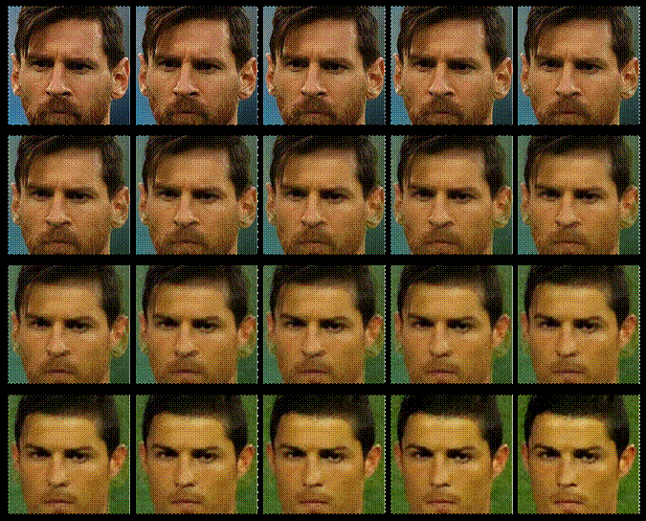
Output

